Slide 1
JOINT STANDARDIZATION BOARD
FUZE & INITIATION SYSTEMS
Sandy Picinic
Area Manager
DISTRIBUTION STATEMENT A
Approved for public release: distribution unlimited
U.S. Army DEVCOM Armaments Center, Army Fuze Management Office
02 AUG 2022

Slide 2
AGENDA
Fuze Engineering Standardization Working Group (FESWG)
Fuze and Initiation Systems
Fuze & Initiation Systems Joint Standardization Bodies
Army Fuze Management Office
FESWG Standards and Progress
NATO Standardization
NATO Document Structure
AC/326 CASG Standardization
SG/A (IST) Program Of Work
SG/A (IST) STANAGS and FESWG standards
Key Takeaways

Slide 3
Joint Standardization Board for
Fuze & Initiation Systems
Under the Defense Standardization Program, the Joint Standardization Boards includes requirements for munition
Fuze & Initiation Systems fulfilled by
DoD Fuze Engineering Standardization Working Group (FESWG)
FESWG is chartered with the purpose to:
  Maintain a DOD-wide working arrangement to prepare and review, in an effective and timely manner, the US and NATO standards, guidelines, and handbooks for fuzes and other initiation systems employed in munitions.
  Serve as a continuing group to facilitate standardization of fuzes and initiation systems, inclusive of associated design concepts, evolving technologies, packaging and logistics techniques, and testing and evaluation procedures, with emphasis on assuring design safety and interoperability.

Slide 4
DoD FESWG OVERVIEW
FESWG Significate Milestones - In operation for over 50 years
2003: Formally Chartered Under the of Defense (signed by DoD Standardization Executive)
2006: Formally chartered under the Joint Standardization Board
100th meeting milestone in February 2020
FESWG Membership well diverse
    Chaired by Army – Army Fuze Management Office (AFMO)
    Membership Includes Executive Secretary, Tri-service member leads, National Laboratories, Subject Matter Experts, Industry & Academia.
Serves as the US body for Fuze & Initiation Systems Standardization.
  Establish and Maintain Fuze & Initiation Systems Engineering Standards
    US Documents
    NATO Documents
  Review and Standardize new technologies for safety
  Interact with Industry
  Advise the Safety Boards
Two Meetings Each Year
Ad Hoc sessions as needed.

Slide 5
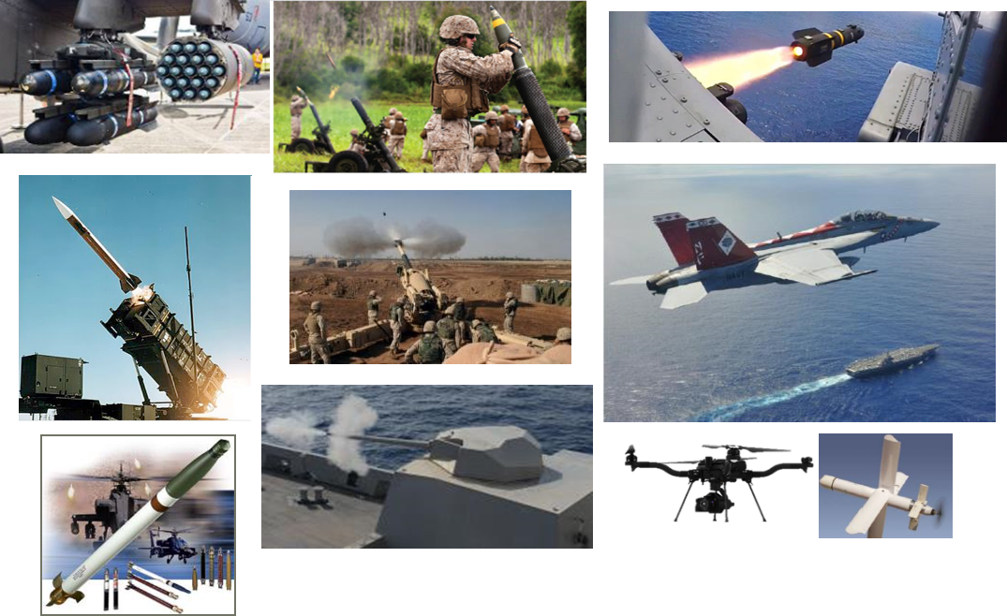
Fuze and initiation systems in dod munitions
Critical technologies for safety, effectiveness,
versatility, and operational efficiency

Slide 6
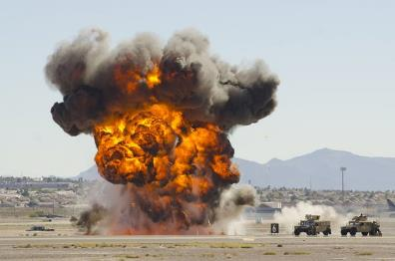
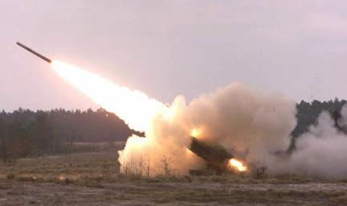
What are Fuze and initiation systems?
Fuze / Fuzing System
A physical system designed to sense a target or respond to one or more prescribed conditions, such as elapsed time, pressure, or command, and initiate a train of fire or detonation a munition’s payload. Safety and arming are primary roles performed by a fuze to preclude initiation of the munition’s payload before the desired position or time.
  Initiation Systems
A physical system to initiate an explosive train or component in a munition.
Examples include ignition systems, active hazard mitigation devices, countermeasures devices, etc.
Fuze systems for warhead detonation
Ignition systems for rocket launch

Slide 7
Fuze & Initiation Systems
Joint Standardization Bodies
DoD FESWG
  Fuze & Initiation Systems standardization
  authority for DOD
  Chaired by:
  Army Fuze Management Office
  Membership:
    Army
    Air Force
    Navy
    Guests and Other Govt Agencies
AC326 SG/A (IST)
  Fuze & Initiation Systems standardization
  authority for NATO
  Chaired by:
  Army Fuze Management Office
  Membership:
    NATO Nations
    Partner for Peace Nations
    Other NATO affiliated Nations

Slide 8
ARMY fuze management office
Provides centralized oversight management
of all non-nuclear Army fuzing throughout the life cycle
Fuze/Munitions
Industrial Base
Joint Standardization Board
Fuze & Initiation Systems
Fuze Safety Boards
Propose, recommend and support actions directed towards ensuring the fuze industrial base is properly maintained
  Key participant of the
  Joint Enhanced Munitions Technology Program (JEMTP)
DoD’s focal point for multi-service and international
Fuze and Initiation systems standardization
    Chair of the DoD FESWG for over 50 years
    Chair of the NATO AC326 Subgroup A on Fuzing and Initiation Systems
    for over 30 years
Chairs and manages the Army Fuze Safety Review Board providing an Independent technical design safety review authority
    Facilitator of the
    Joint Service Fuze &
    Ignition Systems Safety Review Board
Continuous Improvement of Standards among DoD, Industry Partners, Academia & International Partners

Slide 9
Status of dod feswg standards
STANDARDS | ACCOMPLISHMENTS
MIL-STD-1316 (Fuze safety design requirements) | Revision F published on 18 Aug 2017
MIL-STD-331 (Fuze safety test procedures) | Revision D published on 31 May 2017
MIL-DTL-23659 (Qualification tests for electric initiators) | Revision F published on 10 June 2010
MIL-STD-1901 (Launch ignition system safety design) | Revision B in process
MIL-STD-1911 (Hand-emplaced ordnance design safety) | Revision B started
JOTP-050 (Active Hazard Mitigation Device) | Revision A published on 24 June 2019
JOTP-051 (Logic devices) | Revision A in process
JOTP-052 (Fuze safety qualification test program) | Published on 17 March 2012
JOTP-053 (Electrical stress test) | Published on 03 Nov 2015
JOTP-054 (Low Voltage Command Arm) | Published on 17 Oct 2019
MIL-HDBK-145 (US Fuze catalog) | Revision D published on 9 June 2015 (This is continuously being updated)
NEW STANDARDS IN DEVELOPMENT
JOTP-05x (Safety Design Criteria for Remotely Controlled Fuzing Systems used in Munitions)
JOTP-055 (Guidance for Submunition Advanced Features to Meet the 2017 DOD Policy on Cluster Munitions)
JOTP-05x (In-line Initiator Qualification)
Fuze & Initiation Systems Standards are well
positioned to support DoD Modernization and Interoperability Priorities

Slide 10
Key Progress areas
MIL-STD-1901, Revision B
Design safety criteria for ignition systems & ignition safety devices for use with munition rocket and missile motors.
Significant changes include: new definitions, updates consistent with MIL-STD-1316F requirements, multiple-stage initiation systems and qualification requirements.
MIL-STD-1316, Revision F, Notice 1
Design safety criteria for fuzes and Safety and Arming devices that are subsystems of fuzes.
Changes include: definition changes consistent with MIL-STD-1901B and new arming delay requirements.
JOTP-05x (In-line Initiator Qualification)
Establishes the qualification criteria for In-Line Initiators. Leverages from MIL-DTL-23659.

Slide 11
Key Progress areas – cont.
JOTP-055 (Criteria for Submunition Advanced Features to Meet the 2017 DOD Policy on Cluster Munition)
Establishes the design and evaluation criteria for advanced features IAW with paragraph 5.b in the Technical Specifications for the 2017 DoD Cluster Munition Policy.
  Coordinated with OSD Policy and FESWG
  Commenced approval process. Posted to ASSIST on 22 July 2022.
JOTP-05x (Safety Design Criteria for Remotely Controlled Fuzing Systems used in Munitions)
Design safety criteria for fuzes and Safety and Arming devices that are remotely controlled to permit capabilities for safe passage, recovery, and overhead safety operations.

Slide 12
Next FESWG meeting
105th FESWG is scheduled for September 27-29
Meeting to be held at Defense Microelectronics Activity (DMEA)
DMEA was established by the Office of the Secretary of Defense (OSD) to jointly act as the DOD Center for microelectronics technology, acquisition, transformation, and support
Leveraging and sharing knowledge of DMEA highly specialized engineering facilities and microelectronics technology
105th FESWG meeting scheduled for September 27-29 at DMEA

Slide 13
DSP 2022 Presentation on NATO AC326 SG/A Initiation Systems Team (IST)

Slide 14
Nato standardization
NORTH ATLANTIC COUNCIL (NAC)
Conference of National Armament Directors (CNAD)
AC/326 - CNAD Ammunition Safety Group (CASG)
SG/A (EMT)
Energetic Materials
SG/A (IST)
Fuzing & Initiation Systems
Chaired by
AFMO
SG/B
Munition Systems Safety
SG/C
Munition Transportation and Storage

Slide 15
Nato standardization
SG/A Co-Chair Arrangement:
  Chair for Energetic Materials Team
  Chair for Initiation Systems Team (Chaired by AFMO)
Two Meetings Each Year
  Each group meets separately

Slide 16
Nato document structure
Covering Documents
Allied Publications (AP)
STANAG
Allied Standards
NATO STD
STANREC
Standard-Related Documents
(SRDs)
Non-NATO STD
(Civil or National Defense)
Implementation Guide
Document types are defined in the back-up slides.
Catalogue of National Data
Etc.

Slide 17
Ac/326 casg standardization
OBJECTIVES
In support of NATO deployed MISSIONS and OPERATIONS
For the complete Munitions Life Cycle
1
2
  Improve Interoperability and Interchangeability with commonly agreed
    Safety Requirements
    Assessment Tools (Tests & Methodologies)
  Introduce safe and
  reliable Munitions
  into Service
3
4
Give Guidance and
Specifications to
Munitions Designers
  Give Rules and
  Recommendations
  to Logisticians

Slide 18
Linking of nato sg/a (IST) stanags and dod feswg standards
NATO
STANAG 4187 & AOP-4187
STANAGS 4157, AOP-4157 & AOP-20
STANAG 4560 & AOP-43 Characterization tests
STANAG 4368
STANAG 4497
STANAG 4797 and AOP-4797
Incorporated into STANAG 4187
Incorporated into STANAG 4157
Incorporated into AOP-20
STANAG 4369 & AOP-22 Inductive setting for large caliber
STANAG 4547 Inductive setting for medium caliber
STANAG 4593 & AOP-60 Inductive setting for guided large caliber projectile
STANAG 2916
STANAG 4326 & AOP-8 NATO Fuze catalog
STANAG 2818 & AOP-31 Demolition Materiel Design
STANAGS 4363 & AOP-21 Testing for Assessing Detonating Explosive Components
STANAG 4809 & AOP-67 Remotely Controlled Fuzing Systems - In process
DoD FESWG
MIL-STD-1316 (Fuze safety design requirements)
MIL-STD-331 (Fuze safety test procedures)
MIL-DTL-23659 (Qualification tests for EEDs)
MIL-STD-1901 (Launch ignition system safety design)
MIL-STD-1911 (Hand-emplaced ordnance design safety)
JOTP-050 (Active Hazard Mitigation Device)
JOTP-051 (Logic devices)
JOTP-052 (Fuze safety qualification test program)
JOTP-053 (Electrical stress test)
No US document – Use NATO Standard
No US document – Use NATO Standard
No US document – Use NATO Standard
No Active US document – Use NATO Standard
MIL-HDBK-145 (US Fuze catalog)
No US document – US uses own process
No US document – US uses own process
JOTP-05x (Safety Design Criteria for Remotely Controlled Fuzing Systems used in Munitions) – In process
NATO & DoD Fuze & Initiation Systems Standards are closely linked through the work of the FESWG

Slide 19
SG/a (IST) program of work
RECENT ACCOMPLISHMENTS AND CURRENT WORK
STANAG 4187 – PROMULGATED JUNE 2022
STANAG 4560 – APPROVED FOR PROMULGATION JUNE 2022
STANAG 4368 – 1st WORKING GROUP PLANNED – SEPTEMBER 2022
STANAG XXXX – PROPOSED NEW STANAG ON AIRCRAFT PYRO COUNTERMEASURES – ACCEPTED BY CASG
STANAG 4809 – NEW: 85% COMPLETE-EXPECTED COMPLETION 2023
STANAG 2818 – 85% COMPLETE EXPECTED COMPLETION 2023
STANAG 4157 – 1st WORKING GROUP PLANNED – SEPTEMBER 2022
TERMINOLOGY – REVIEW COMPLETE. DEFINITIONS SUBMITTED TO NATO TERMINOLOGY OFFICE
September 19-23 Meeting to be held in Ottawa, Canada
(1st in-person meeting since September 2019)
Program of Work is reviewed and approved by the CASG
All Subgroups report their work progress to CASG twice per year.

Slide 20
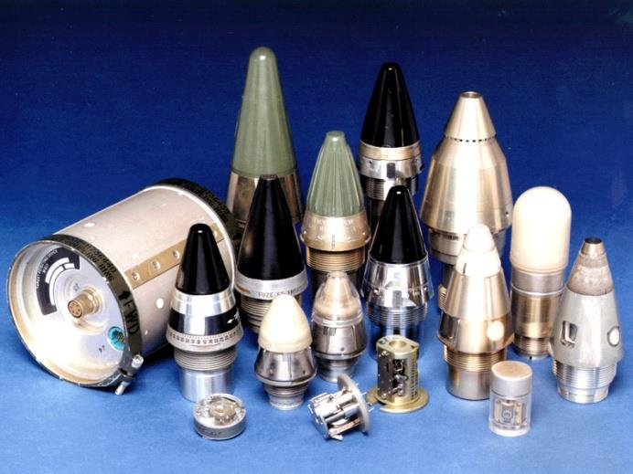
Key takeaways
Chaired and managed by AFMO, standardization activities are seamlessly coordinated among Domestic and NATO communities, industry partners and academia
DoD FESWG, under charter by the JSB, is the fuze and initiation systems standardization custodian for
the USA
Promote interchangeability,
safer munitions & interoperability
Standards Are Well
Positioned To Support DoD Modernization Priorities
Promotes both DoD & NATO interoperability for munition fuzing & ignition systems
Fuze & Ignition systems Standardization products account for changes in technology, DoD Policy, DoD munition modernization efforts, and international interoperability

Slide 21
Questions?

Slide 22
For additional information
Mr. Homesh Lalbahadur
Chairman, DOD FESWG / Chief, Army Fuze Management Office
DEVCOM Armaments Center,
Picatinny Arsenal, NJ 07806-5000
973-724-3042
homeshwar.r.lalbahadur.civ@army.mil
Mr. Tony DiGiacomo
Area Manager, Army Fuze Management Office
DEVCOM Armaments Center,
Picatinny Arsenal, NJ 07806-5000
973-724-9451
anthony.j.digiacomo.civ@army.mil
Ms. Sandy Picinic
Area Manager
Army Fuze Management Office
DEVCOM Armaments Center,
Picatinny Arsenal, NJ 07806-5000
973-724-7172
sandy.d.picinic.civ@army.mil

Slide 23
Back-up

Slide 24
Nato standardization (aap-03 (k))
1.6.1 NATO STANDARD AGREEMENT
1. A NATO Standardization Agreement (STANAG) is a NATO standardization document that specifies the agreement of member Nations to implement a standard, in whole or in part, with or without reservation, in order to meet an interoperability requirement.
2. An Allied standard covered by a STANAG is implemented, as applicable, and complied with to the maximum extent possible by ratifying Allies, adopting partner nations and NATO bodies. Sections on “interoperability requirements” and “implementation of the agreement” are included in each STANAG. They specify the interoperability requirements substantiating the STANAG and provide guidance to assist Nations and NATO bodies with the implementation of the covered Allied standards.

Slide 25
Nato standardization (aap-03 (k))
1.6.1.2 NATO STANDARDIZATION RECOMMENDATION (STANREC)
1. A STANREC is a NATO standardization document used exclusively in the materiel field of standardization that lists one or several NATO or non-NATO standards relevant to a specific Alliance activity unrelated to interoperability.
2. A STANREC is a non-binding covering document used to recommend useful practices in multinational cooperation. It is employed on a voluntary basis and does not require commitment of Allies to implement the Allied standards it covers.

Slide 26
Nato standardization (aap-03 (k))
1.6.2 ALLIED STANDARDS
Allied standards are standards developed or selected in the framework of the NATO standardization process.
NATO recognizes the following concept of a standard by ISO/IEC : a standard is a document, established by consensus and approved by a recognized Body that provides, for common and repeated use, rules, guidelines or characteristics for activities or their results, aimed at the achievement of the optimum degree of order in a given context.

Slide 27
Nato standardization (aap-03 (k))
1.6.2.2 NATO STANDARD
A NATO STD is a standard developed by NATO and promulgated in the framework of the NATO standardization process.
1.6.2.3 NON-NATO STANDARD
A non-NATO STD is a standard developed outside NATO. Non-NATO standards include civil standards, national and multinational defence standards. Non-NATO standards might be referred to or adopted by NATO. Their content might also be reproduced in NATO standards.
1.6.3 STANDARD-RELATED DOCUMENT (SRD)
A SRD is a NATO standardization document that facilitates understanding and implementation of one or more Allied standards. It may provide additional data and information to support the management and implementation of Allied standards. Examples are national data catalogues, standards implementation guides, etc.

Slide 28
Ac/326 casg standardization
AC/326 CASG TASKS
  To develop Standards and Guidance for safe munitions
  Promote interoperability and interchangeability
  To provide Advice and Expertise
In order to guarantee that the Risks presented by Munitions to be used jointly by NATO Forces during co-operations are:
  Well assessed
  At an acceptable level
  Reduced to a minimum

